Slide 1
LOVE OUR NATURE
TITLE: GREENHOME EFFECTS
AND
MEASURES TO OVERCOME THE GREENHOUSE EFFECT

Slide 2
GREENHOME EFFECTS

Slide 3
INTRODUCTION
Greenhouse effect is due to heat seepage.
Among some types of greenhouse gases available are carbon dioxide and nitrogen oxides.

Slide 4
GREENHOUSE EFFECT CONCEPT
Is a phenomena closely related to globals warming.
The release of carbon dioxide gas has become a major cause of the greenhouse effect.
Solar light carries ultraviolet rays to the earth but the heat that gets to surface of the earth can not be released due to being blocked by carbon dioxide gas that covers the atmosphere.as a result of the earth’s temperature is getting hotter.

Slide 5
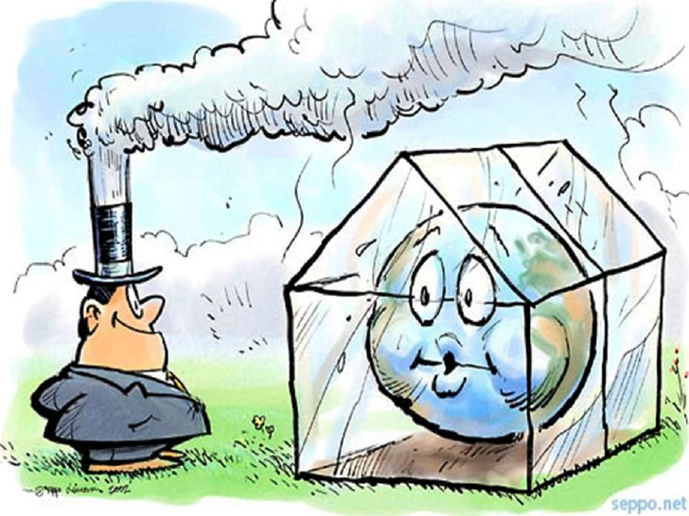

Slide 6
GREENHOUSE EFFECT PROCESS
Occurs when the composition of greenhouse gases such as carbon dioxide,carbon monoxide and nitrogen dioxide increases above normal levels.
When the composition of the gases increases thease gas molecules are heat-saving and slow down the prosess of heat release.

Slide 7
IMAGE OF GREENHOUSE EFFECT PROSESS

Slide 8
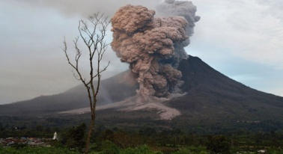
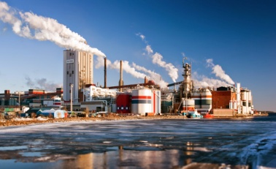
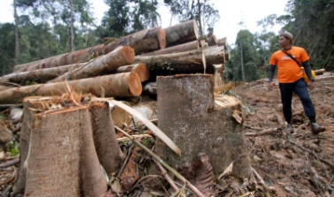
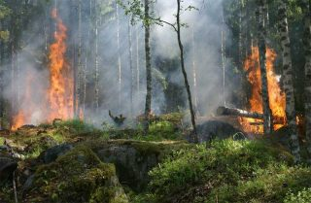
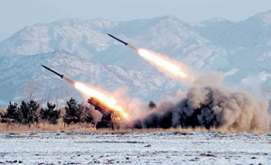
CAUSE
Volcanic eruptions
Industrial
Logging
Forest burning
Nuclear test/missile

Slide 9
EFFECT
ENVIROMENT
1.Damaging habitat
2.Causing extinction of fauna and flora
3.Disrupting the natural cycle
4.Environmental pollution
5.Sea level rise

Slide 10
HUMAN HEALTH IS DISTURBED
Temperature changes cause ‘heatware’ in some places and areas especially the elderly suffer from ‘heatstroke’.
Freshwater shortages and flood events cause polluted and subsequently result in diseases such as diarrhea.

Slide 11
DAILY HUMAN ACTIVITIES AND PLACEMENT ARE DISRUPTED
Climate zone transfers and seawater movement as well as flood events affect fishing and other quatic life.
Natural disasters like storms and droughts cause power supply disruption.

Slide 12
MEASURES TO OVERCOME
THE
GREENHOUSE EFFECT

Slide 13
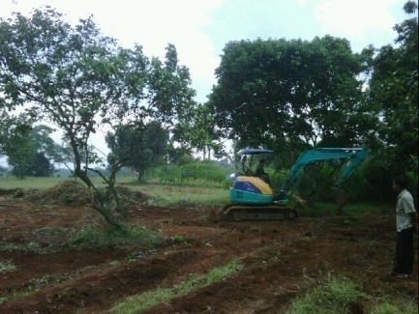
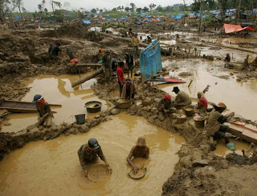
MEASURES TO OVERCOME THE GREENHOUSE EFFECT
Limiting logging activities
Control the opening of new land
Limiting mining activity

Slide 14
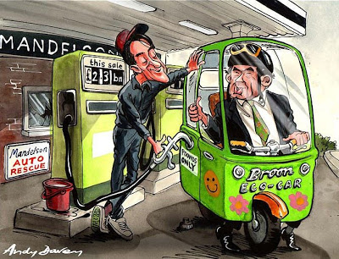
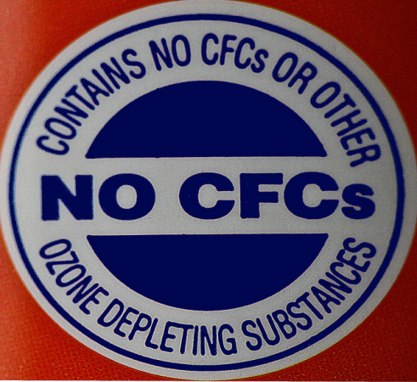
Reduce unleaded gasoline
Share a vehicle
Reducing the use of CFC items

Slide 15
THE ROLE OF GOVERNMENT IN CONCERNING GREEN HOME EFFECTS
1.Helps illegal logging activities
2. Catch rain catchment
3. Intensifying replanting
4. Enforcing laws in the production of smoke and toxic waste in the industry.

Slide 16
CONCLUSION
All parties should work together to reduce the impact of greenhouse gases.
The government, the private sector, the community and ourselves need to be aware of our world.

Slide 17
LOVE THE EARTH SAVE THE GENERATION

