Slide 2
Are We Responsible For The World We Live In

Slide 3
MEANS AND DEFINITION
The definition of responsible for the world we live in, as we know it as social, culture, economic and environment. Here we are more focused and emphasizing on keeping the environment. For example it’s very important to humans as food resources, charity and communication tools.

Slide 4
GAIN AND BENEFITS

Slide 5
Humans are hard-wired to love – and need – exposure to the natural world
Nature brings our senses alive
Are we responsible for the world we live in
Individuals and businesses can become nature smart
Nature heals
Nature can reduce depression and improve psychological wellbeing

Slide 6
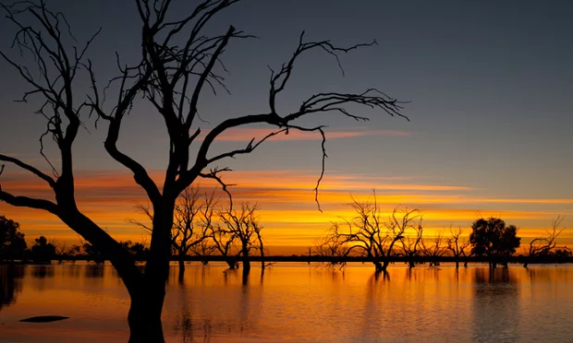
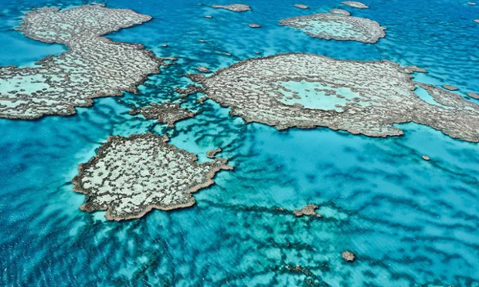
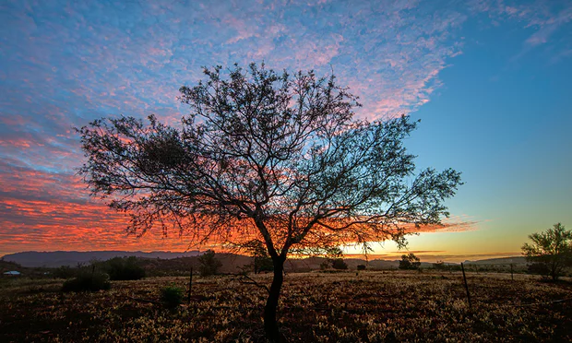

Slide 7
HARMING AND DISASTERS

Slide 8
Global Warming
Pollution
Climate Change
Overpopulation
10 WAYS HUMANS IMPACT THE ENVIRONMENT
Genetic Modification
Ocean Acidification
Ozone Depletion
Acid Rain
Water Pollution
Deforestation

Slide 9
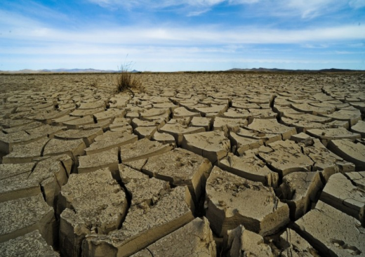
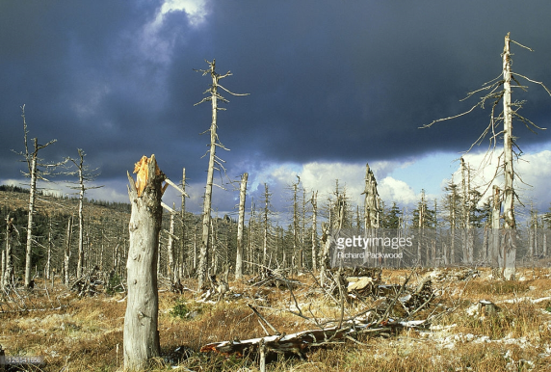
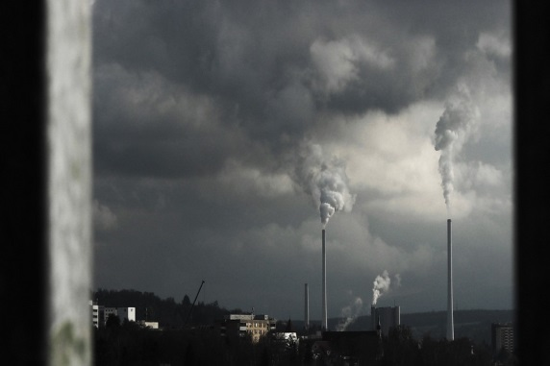
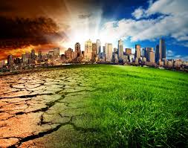
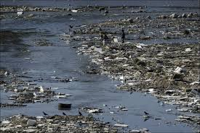
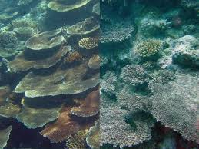
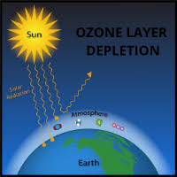
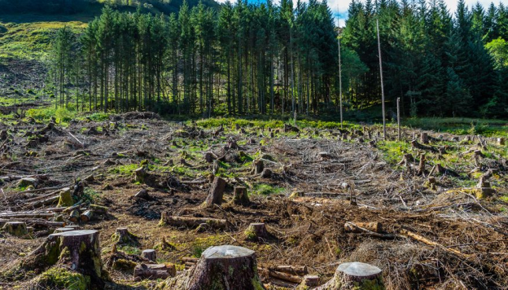
Global Warming
Acid Rain
Pollution
Overpopulation
Water Pollution
Climate Change
Deforestation
Ocean Acidification
Ozone Depletion

Slide 10
RESPONSIBLE

Slide 11
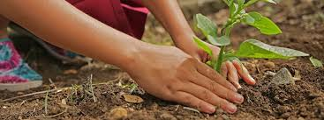
Responsibility
We are being responsible that people and organizations must behave ethically and with sensitivity toward social, cultural, economic and environmental issues.

Slide 12
CONCLUSION

Slide 13
Let us work together to ensure that this is the ultimate ending persists. It is up to us as parents, teachers, physicians and responsible adults to make it happen.

